Slide 1

GTU CSE ENG CSE 496 FINAL-PRESENTATION pıcker & packer applıcatıon
Furkan OZEV
Project Advisor: Doc. Dr. Habil KALKAN
January 2022

Slide 2
Contents
Project SchemA and Description
Project DesIgn Plan
Success CrIterIa
resources
Project RequIrements
TImelIne

Slide 3
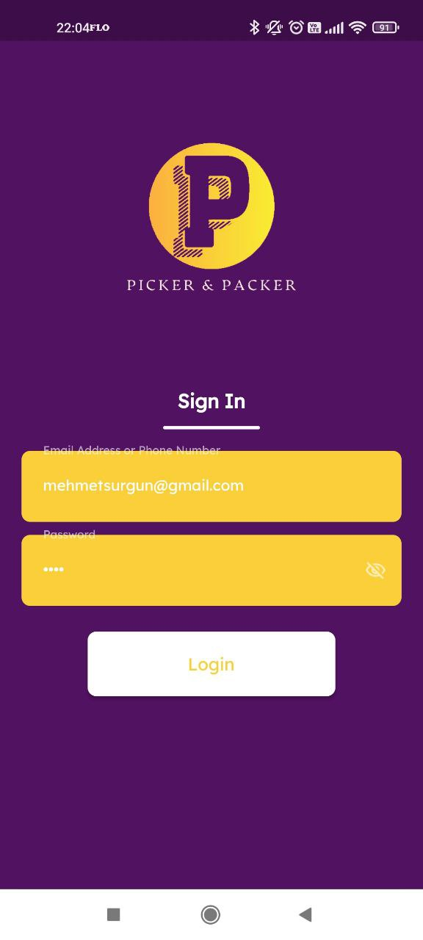
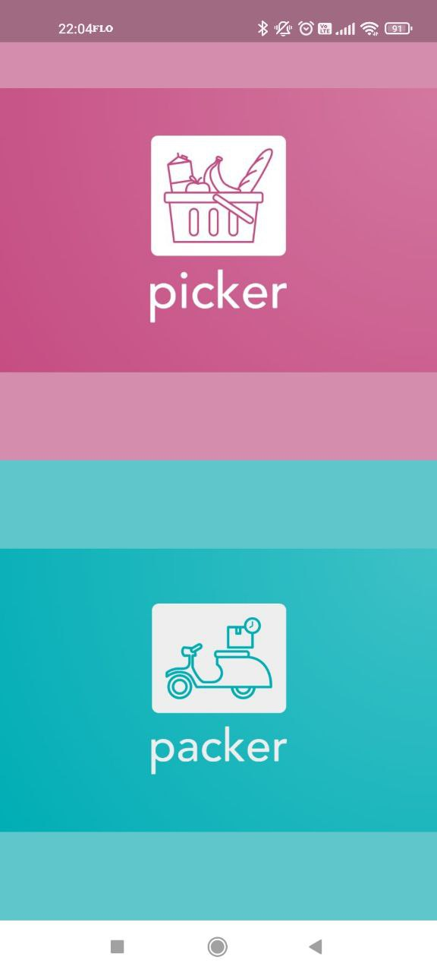
Project SchemA and Description PICKER and packer
Today, most of our grocery shopping has moved to digital. Now we can easily place our orders from mobile applications and receive them in a short time. In our project, we did not develop the application where users create orders, we developed an application for the use of employees who are in the process of preparing and delivering orders. It can be used by a single application and 2 different types of employees at the same time. These are pickers and packers. The picker will take care of the preparation process of the order and the packer will take care of the delivery process of the order.

Slide 4
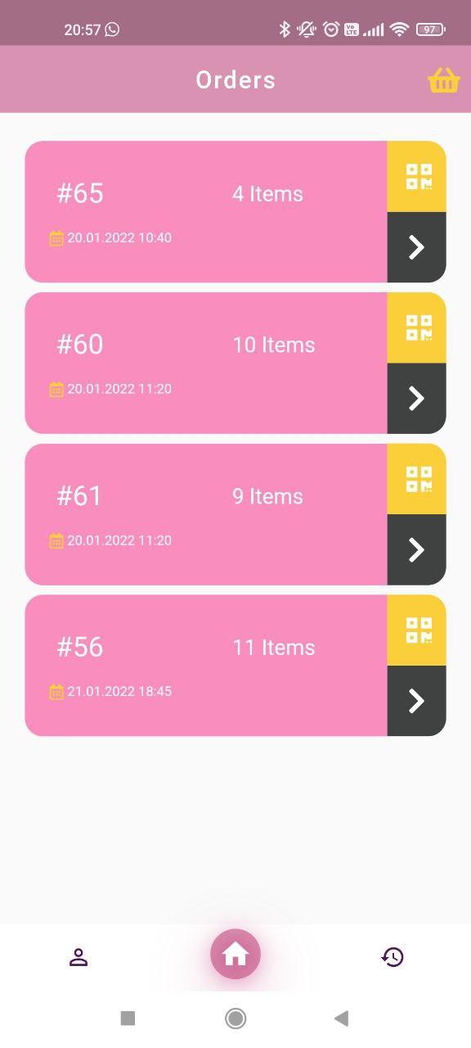
Project SchemA and Description PICKER
Show&Edit User Informations
Optimized Product Preparation Suggesstion
Show Order Details; Accept or Cancel
Cancel or Change Products
Show Previous Order Details
Barcode Product Scanning
Handle Multiple Orders
Register Checkout
Description : The main task of Picker is to prepare the orders given by the users and deliver them to the checkout register. When the order arrives, picker can view and proceed to the order preparation process. Picker starts with the product ranking and category suggested by the application during the collection phase, so picker will optimally collect products in the same category. Application will suggest the latest collection of cold chain products. Before adding the product to the cart, picker will scan it with barcode.

Slide 5
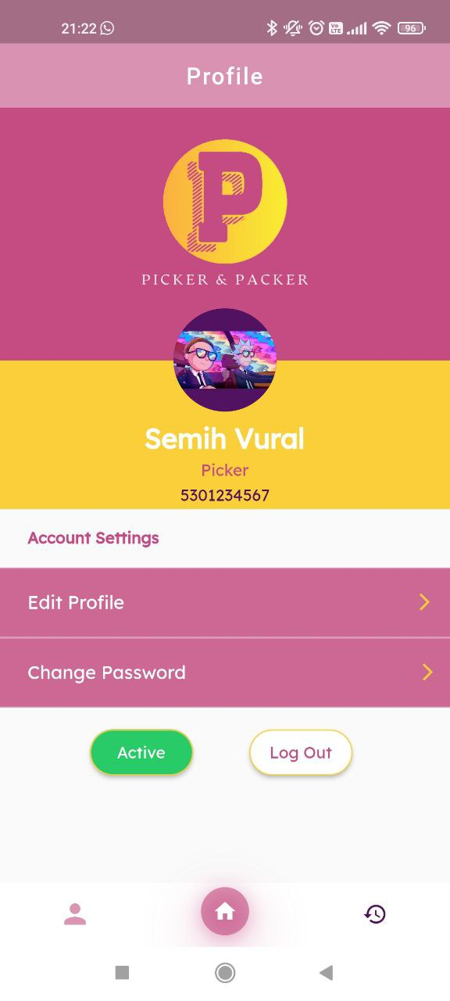
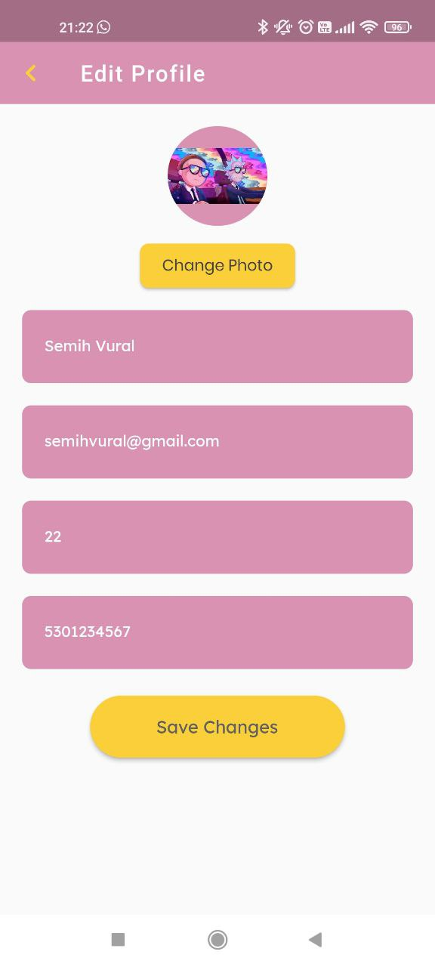
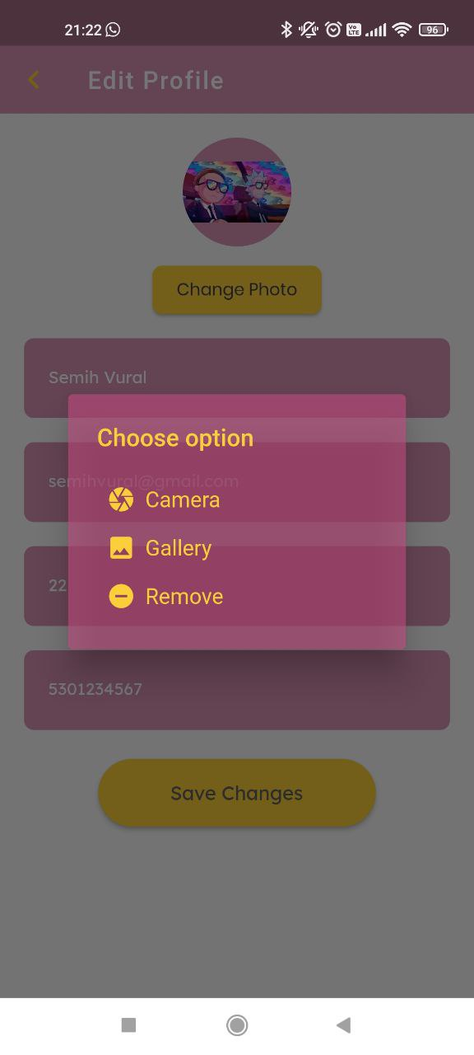
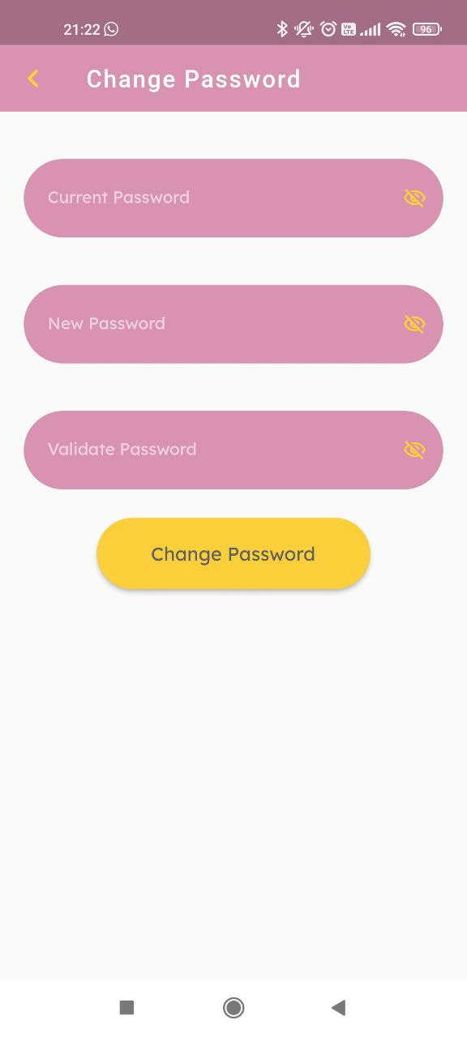
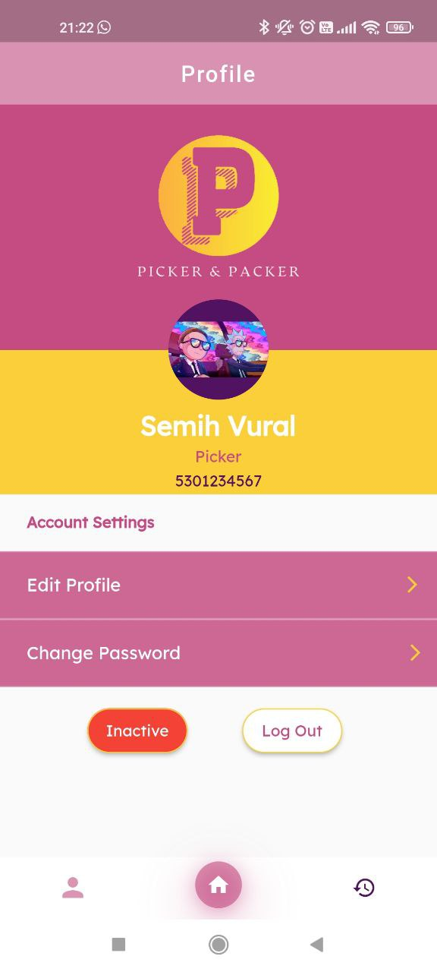
PROFILE PICKER
Picker can view and change profile information. It can update or remove his photo. It can change his password. It can change its status to active and inactive. While it can receive new orders in active state, it will not receive new orders in inactive state.

Slide 6
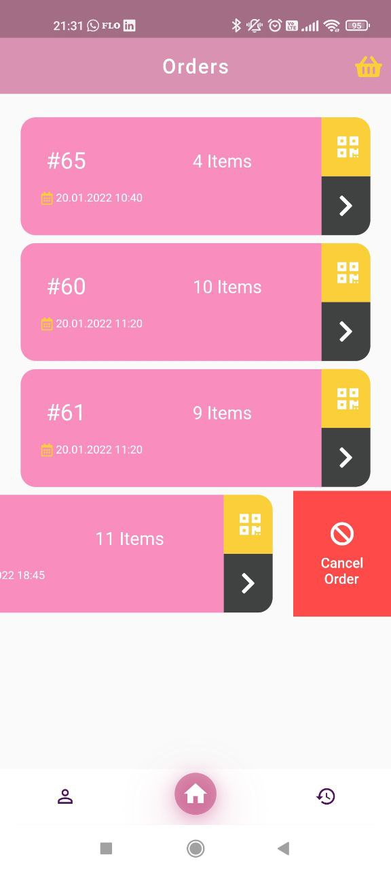
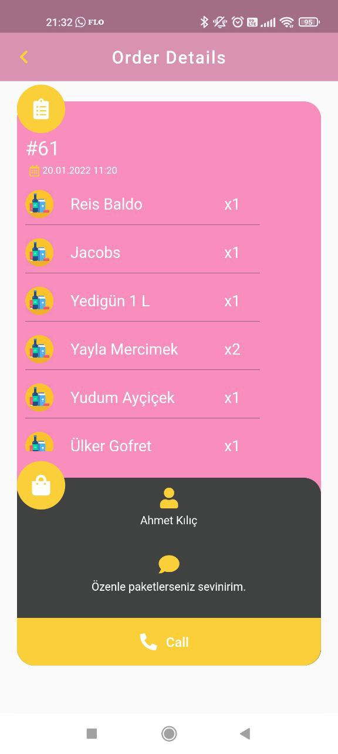

order & Detaıls PICKER
Picker can view active orders, view order details and products. It can call the customer. It can cancel the order. It can scan the barcode of one of the carts that is not in use to include the order in the preparation process, so that that cart is assigned to the relevant order.

Slide 7
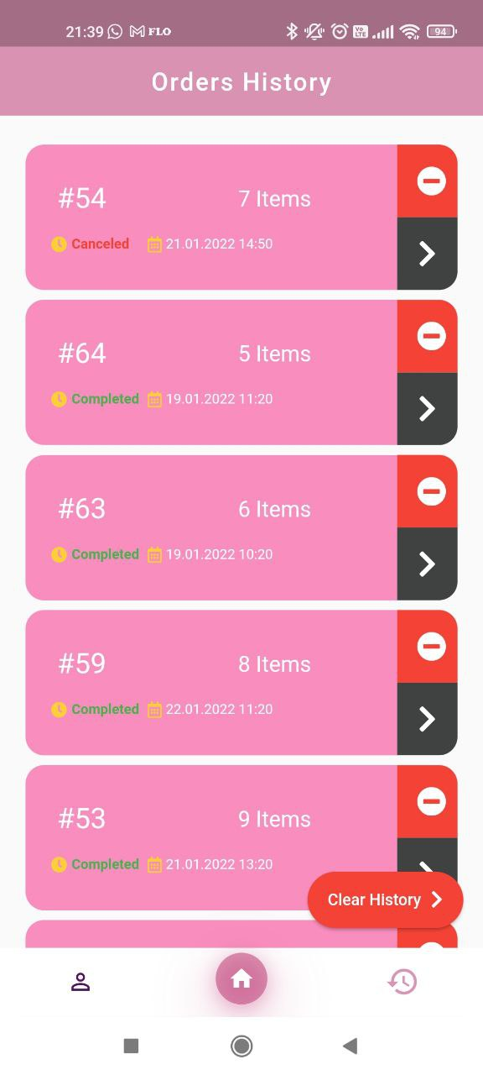
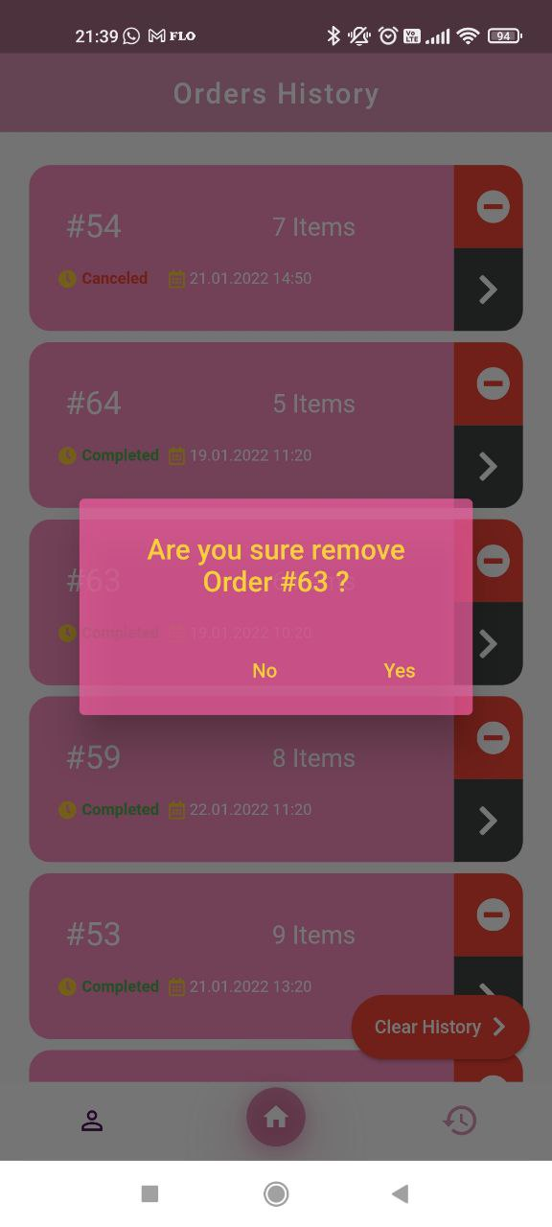
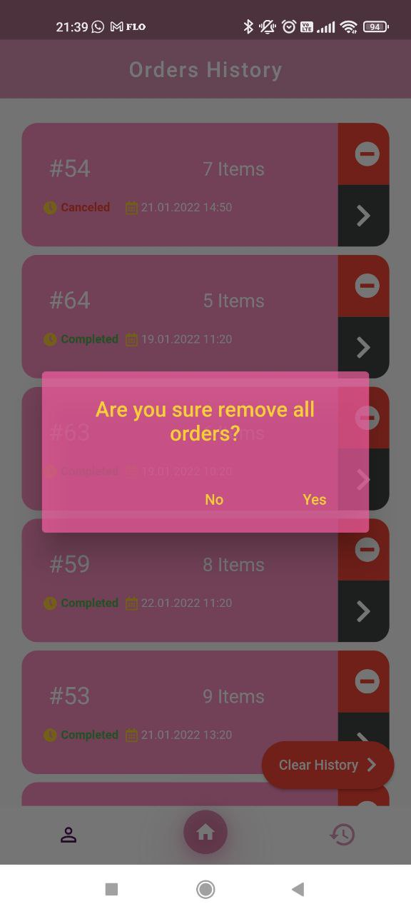
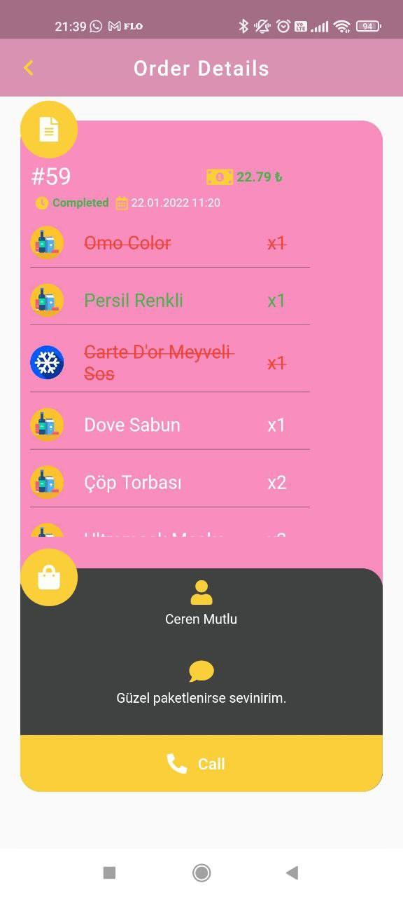
Prevıous Order & Detaıls PICKER
Picker can view active orders, order details and products. Canceled products, added products and changed products are indicated in the details. The price difference resulting from the change is indicated in the details. The completion and cancellation status of the order is indicated. Any order can be deleted from the history or all orders are deleted from the history.

Slide 8
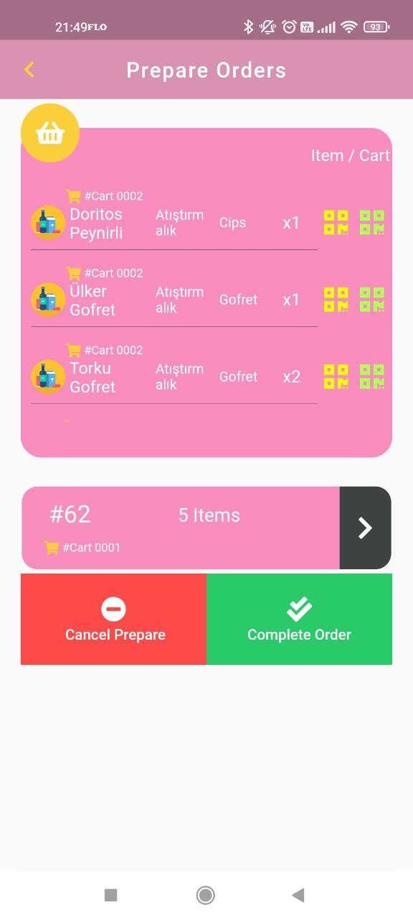
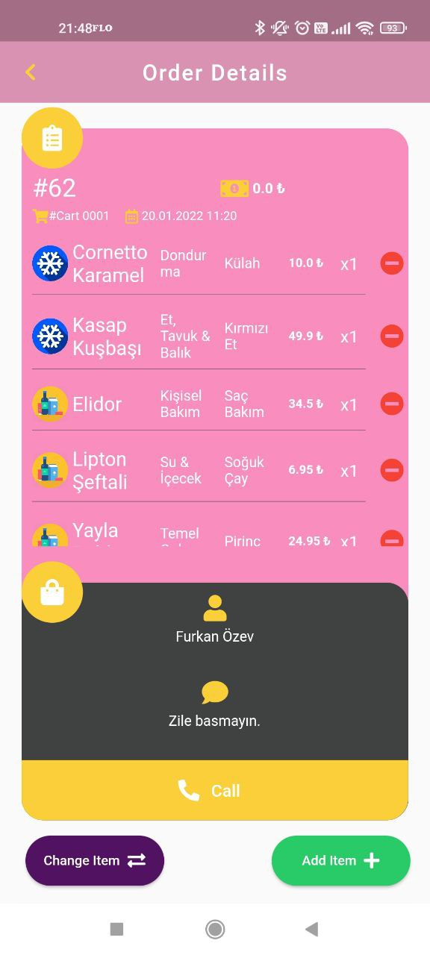
PREPARE Order & Detaıls PICKER
Picker can handle multiple orders at the same time during the preparation phase. It can view the orders, order details and products in the preparation phase.
It can make changes to the products in the order; The product can be canceled, an equivalent product can be added instead of the existing product, a new product can be added, the number of the existing product can be increased or decreased.
Picker is advised to pick products in an optimal way, so picker can prepare orders with the least effort. While preparing the orders, it adds the order to the cart by scanning the product barcode and scanning the cart barcode.
Picker can cancel the order preparation phase and delete the changes. It completes the order and assigns the order to a related packer.

Slide 9
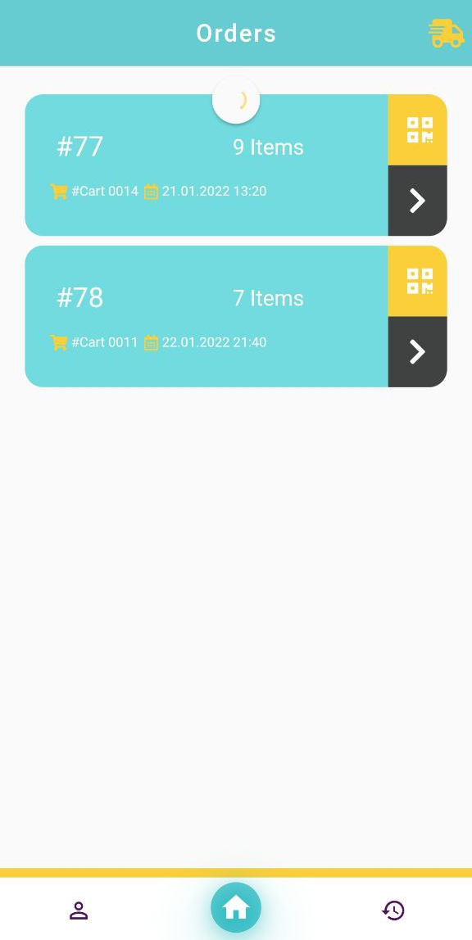
Project SchemA and Description PACKER
Show&Edit User Informations
Show Delivery Address
Show Payment Fee
Show Order Details; Accept or Cancel
Optimized Route Suggesstion
Show Previous Order Details
Change Order Status (Delivered, Canceled)
Handle Multiple Orders
Register Checkout
Packer's main task is to pick up the order prepared by Picker from the checkout register and deliver it to the address. When the order is prepared, packer can view it and proceed to the order delivery process. When starting the order receiving process, it goes to the relevant checkout and registers and receives the products. During the order delivery phase, it will deliver the orders on the route suggested by the application.

Slide 10
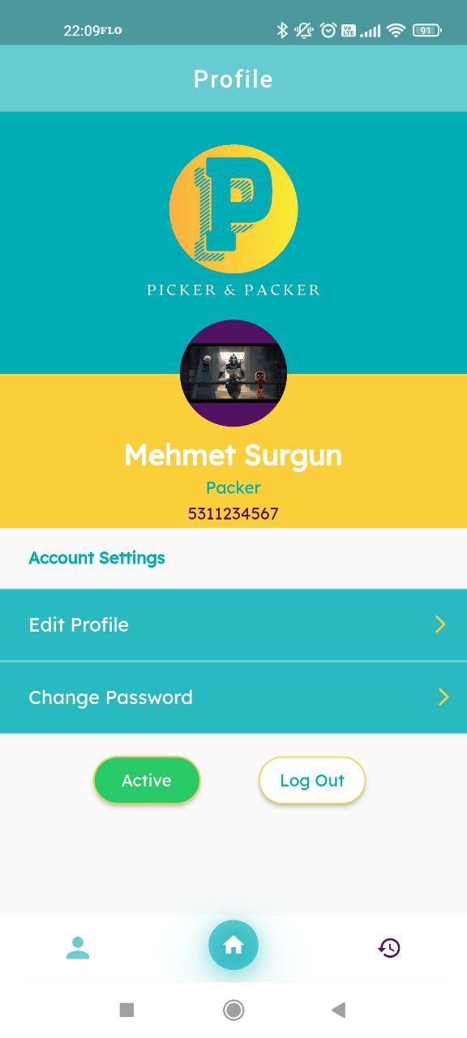
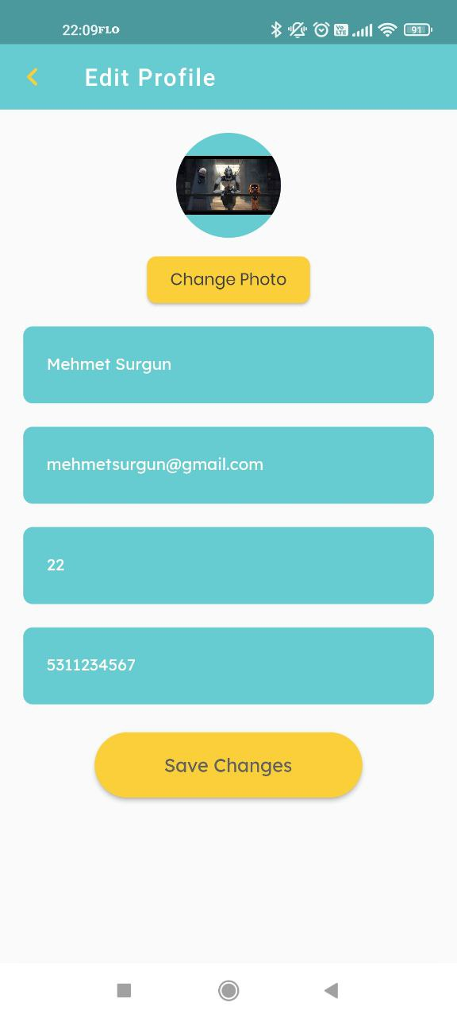
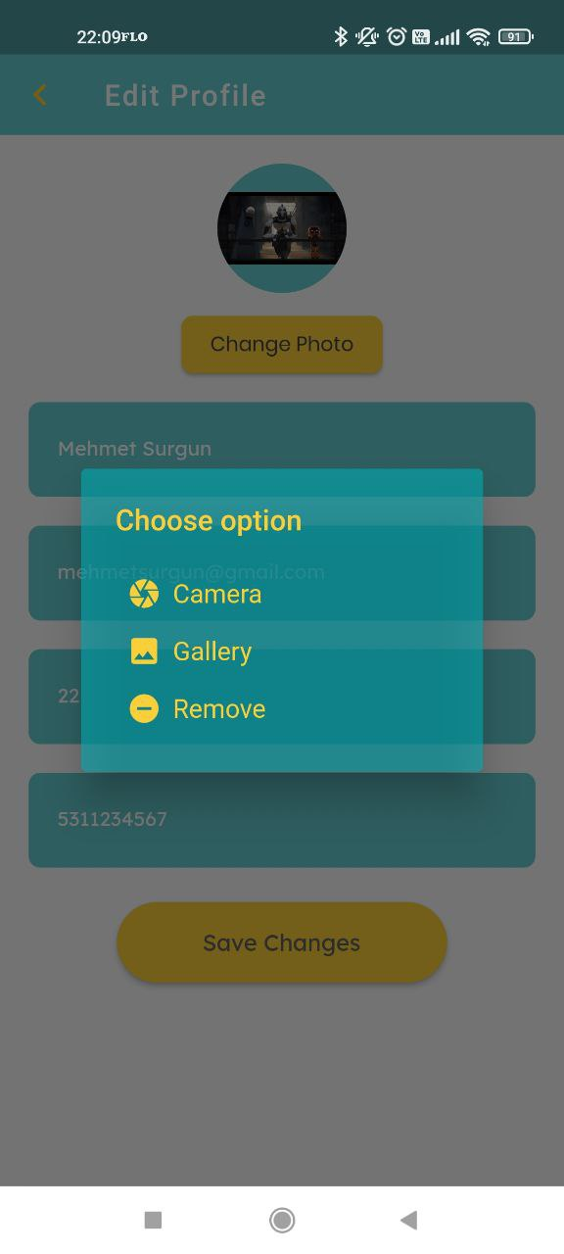
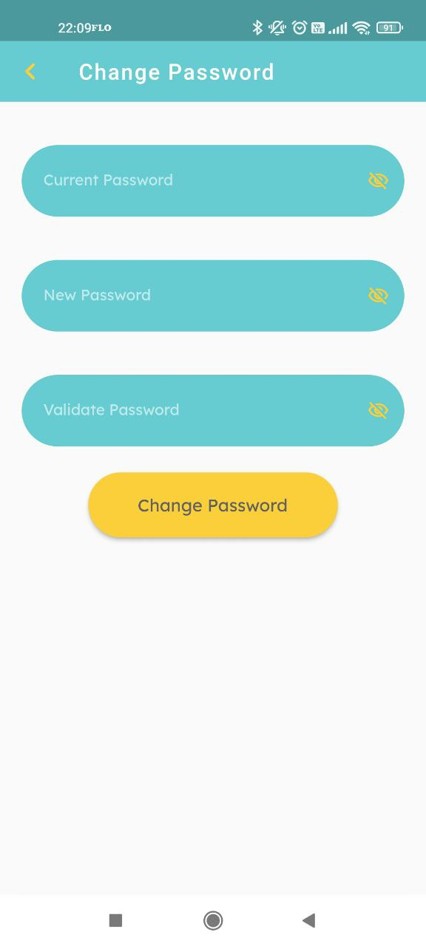
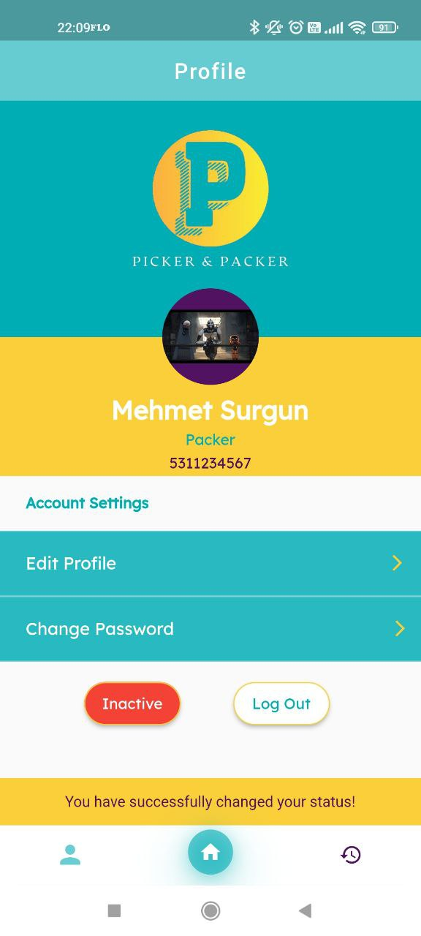
PROFILE PACKER
Packer can view and change profile information. It can update or remove his photo. It can change his password. It can change its status to active and inactive. While it can receive new orders in active state, it will not receive new orders in inactive state.

Slide 11
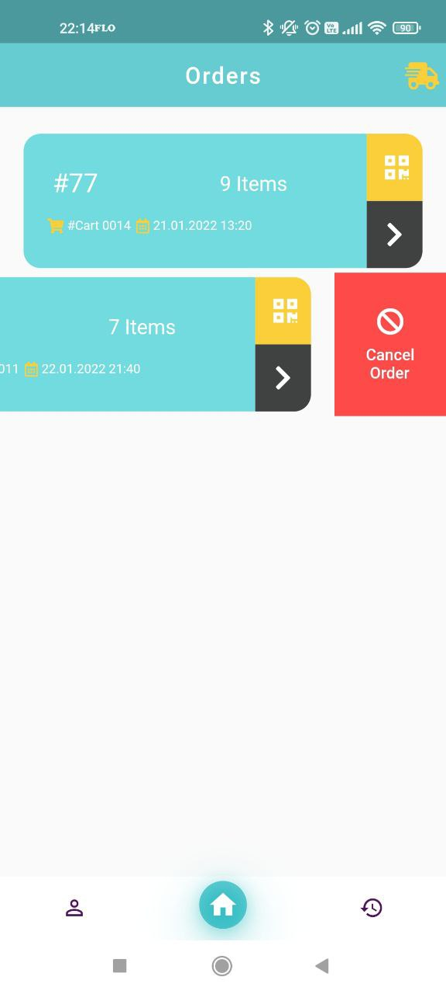
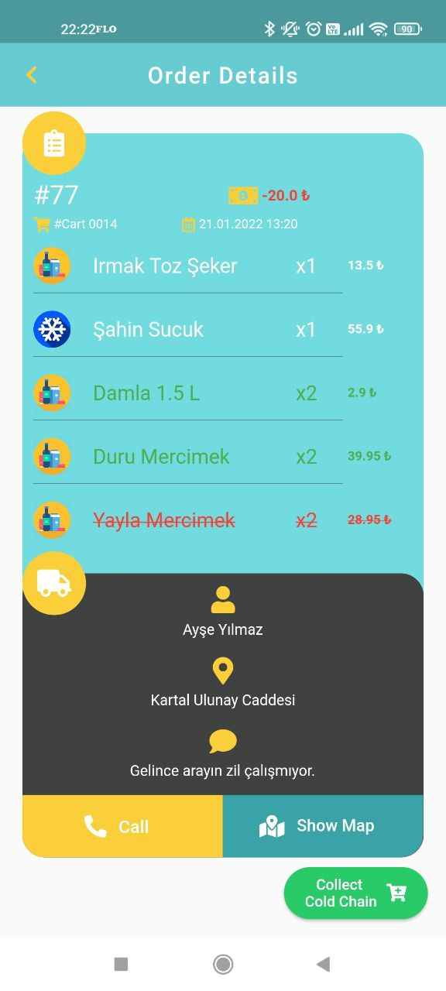
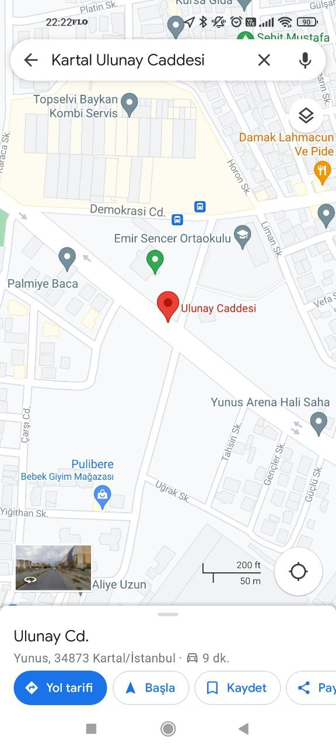
order & Detaıls PACKER
Packer can view active orders, order details and products. It can call the customer and view the order address on the map. It can view product changes and price difference made by Picker. It can cancel the order. If there is a cold chain product in the order, Packer must confirm receipt. It can scan and match the specified cart barcode and include it in the delivery process.

Slide 12
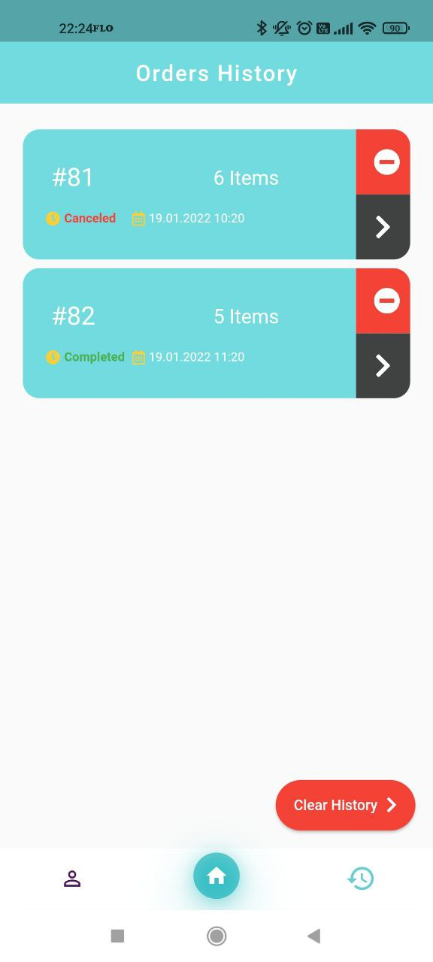
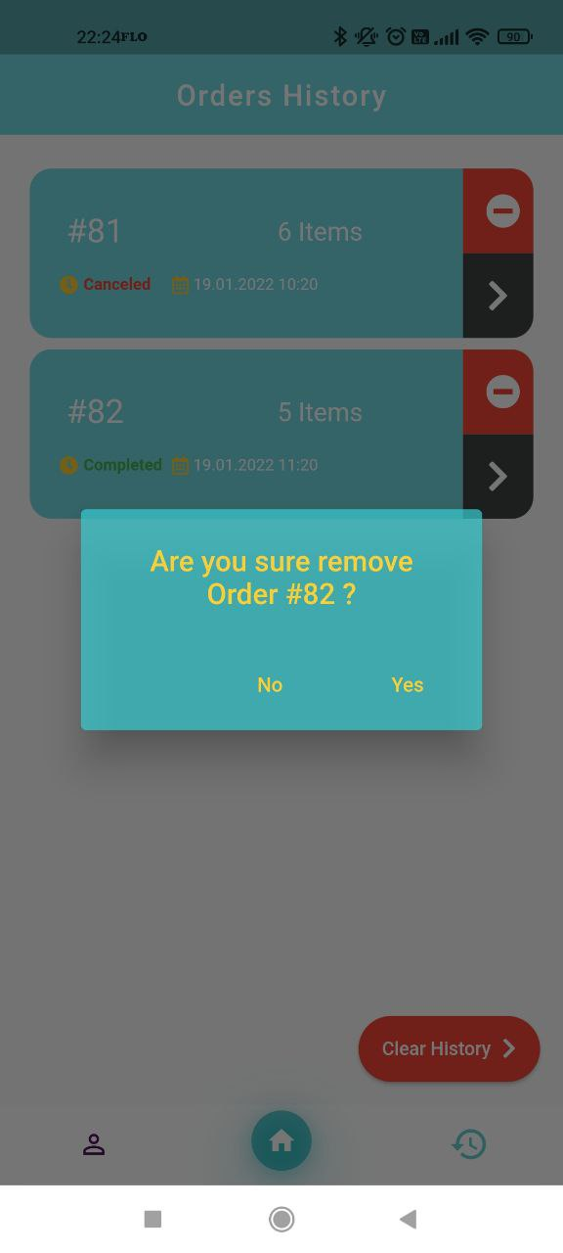

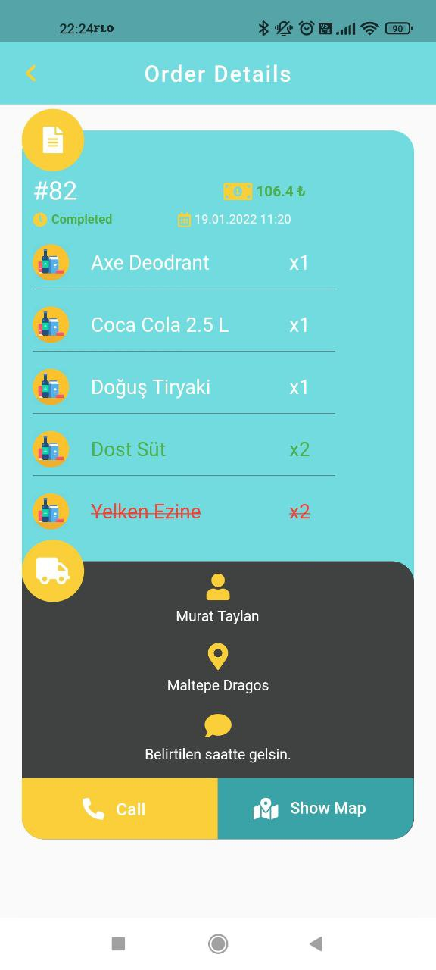
Prevıous Order & Detaıls PACKER
Packer can view active orders, order details and products. Canceled products, added products and changed products are indicated in the details. The price difference resulting from the change is indicated in the details. The completion and cancellation status of the order is indicated. Any order can be deleted from the history or all orders are deleted from the history.

Slide 13
Addıtıonal Enhancements
Although a customer and store management application is not available, APIs have been developed to integrate directly into the application in the future.
Adding a new order to Picker.
When adding an order to Picker and Packer, the order is automatically assigned to the person who is active and has the least number of open orders.
Adding and changing new categories, sub-categories and products to the database.
Update product price information.
Adding new employee, updating profile, viewing information, view completed order, canceled order, open order information, view last login date.
View information, performance status (completed, canceled, open order counts) and last login date of all employees or a specific employee.
Changing the activity status of any employee.
View and filter specific or all orders.
Update information about orders.
By using Google Map APIs, orders were optimally sorted according to instant location and traffic data, estimated delivery time and distance information was provided.
The SHA256 hash information of the user passwords is kept in the database and this hash information is sent when the user logs in. Thus, password security is provided.
Others...

Slide 14
FLUTTER
The widgets, models and animations provided by Flutter were used. The development is based on the MVC model. In the code, data is in classes called models, RESTAPI requests are in classes called provider, and interface pages are in classes called View.
SnackBar
AlertDialog
Email Validator
AppBar
Navigation Bar
Refresh Indicator
Slidable
ListView
Call Launcher
Map Launcher
Barcode Scanner
Image Picker
Page Transition
Geolocator
SpinKit Custom Loading
Others...

Slide 15
API & CLOUD & DATABASE
Around 70 APIs have been developed using the Flask framework in Python using the RESTAPI architecture.
APIs were tested using the Postman application.
PostgreSql, which is one of the relational database types, was preferred as the database.
There are 10 tables: Account, Carts, Category, Item, Packer_user, Packerorders, Packerorderitems, Picker_user, Pickerorders, Pickerorderitems.
In these tables, there are constraints such as primary, foreign key and relations between them.
Heroku and Render platforms were preferred to present APIs in the cloud. In addition, PostgreSql databases serving in the cloud environment provided by these platforms were used.
Google Map Directions and Google Map Distance Matrix APIs provided by Google Developer were used as 3rd party APIs.

Slide 16
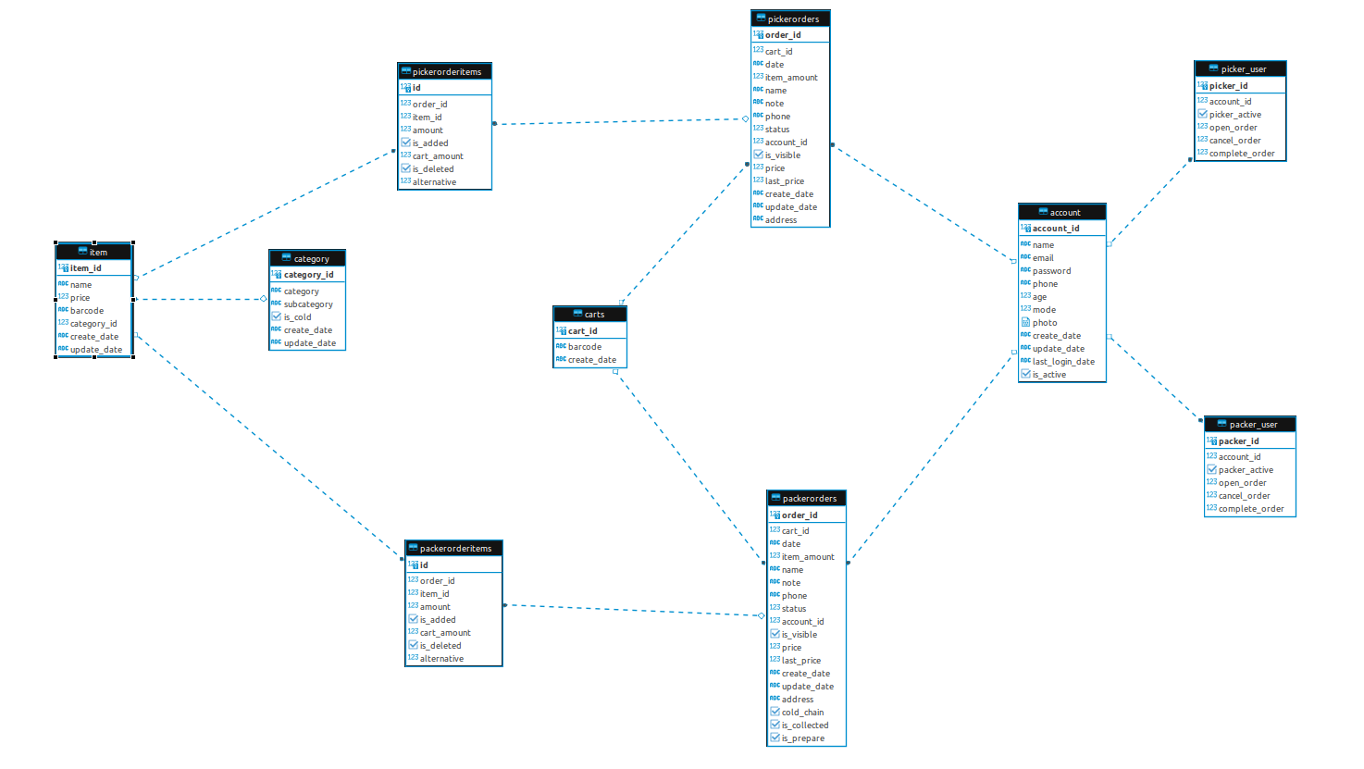
API & CLOUD & DATABASE

Slide 17
Success CrIterIa - 1
It meets 70% validity criteria when tested by 10 different users. (Simplicity, Usability, Functionality, Design)
It can run on devices running Android 7.1.1 (Nougat) and above.
Providing product barcode scanning and Map integrations.
Providing optimal product collection suggestion and the most optimal route. (All permutations will be taken and compared.)

Slide 18
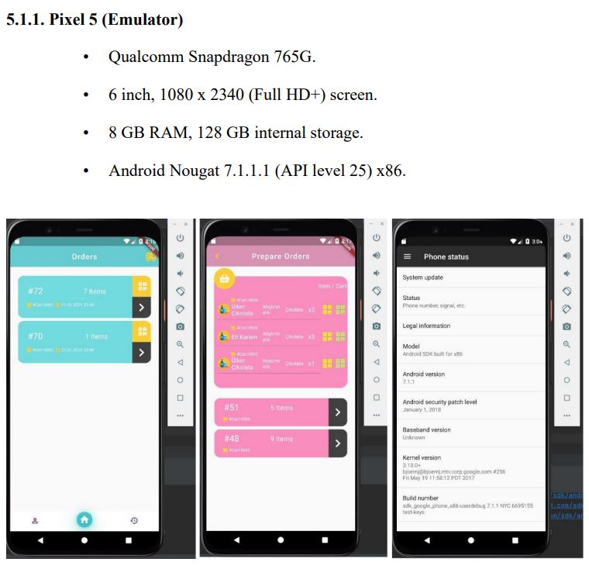
Success CrIterIa - 1
It can run on devices running Android 7.1.1 (Nougat) and above.

Slide 19
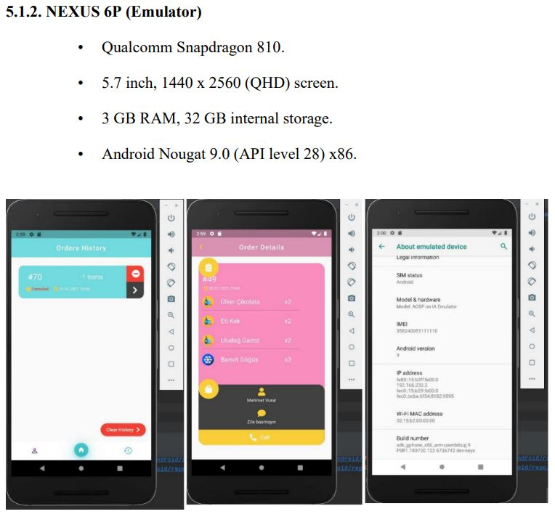
Success CrIterIa - 1
It can run on devices running Android 7.1.1 (Nougat) and above.

Slide 20
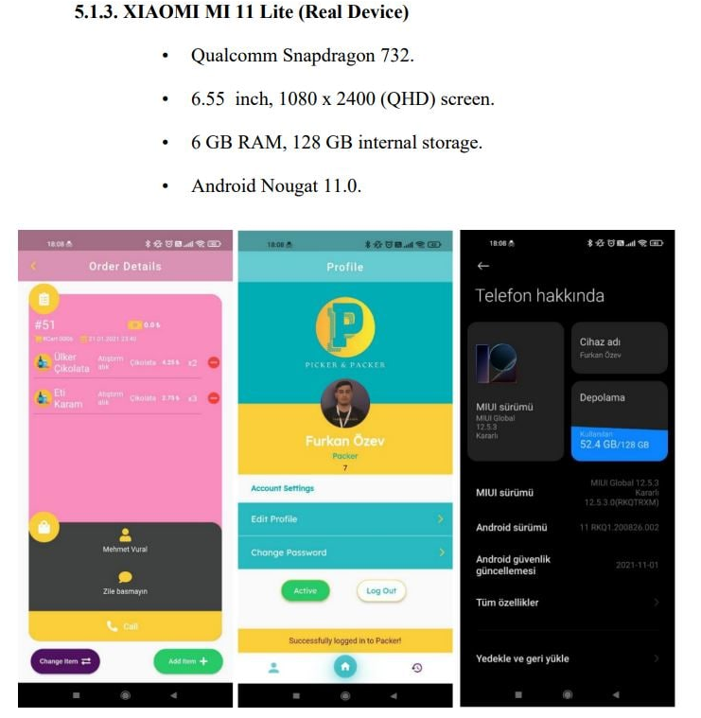
Success CrIterIa - 1
It can run on devices running Android 7.1.1 (Nougat) and above.
As seen in the results, it has been tested on different types of devices, different android versions, including Android 7, Android 9, Android 11, and success criteria have been met.

Slide 21
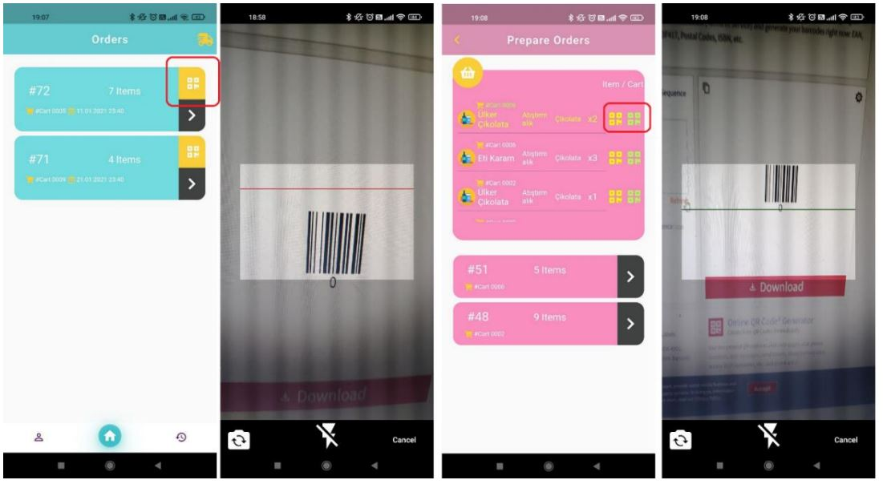
Success CrIterIa - 2
Providing product barcode scanning and Map integrations.
Most pages of the application have barcode scanning functionality. Both Picker and Packer are used for both cart scanning and product barcode scanning. Therefore, this criterion has been met.

Slide 22
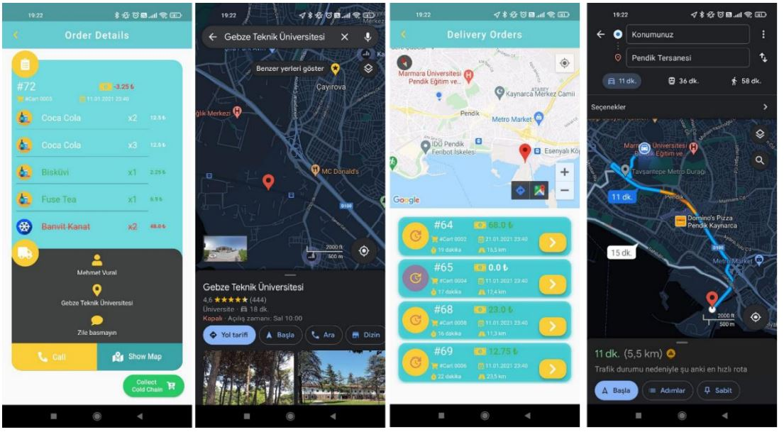
Success CrIterIa - 2
Providing product barcode scanning and Map integrations.
Packer can view the relevant address on the Google Map application and get route directions by pressing the Show Map button on all relevant pages. In addition, on the Delivery page, it can display its current location, mark the order addresses on the map, and display the distance and time to the address. The geolocator module in Flutter is used to get the current location. The map launcher module in Flutter was used for the Show Map button. Directions and Distance Matrix APIs provided by Google Map were used for Map-related functions..

Slide 23
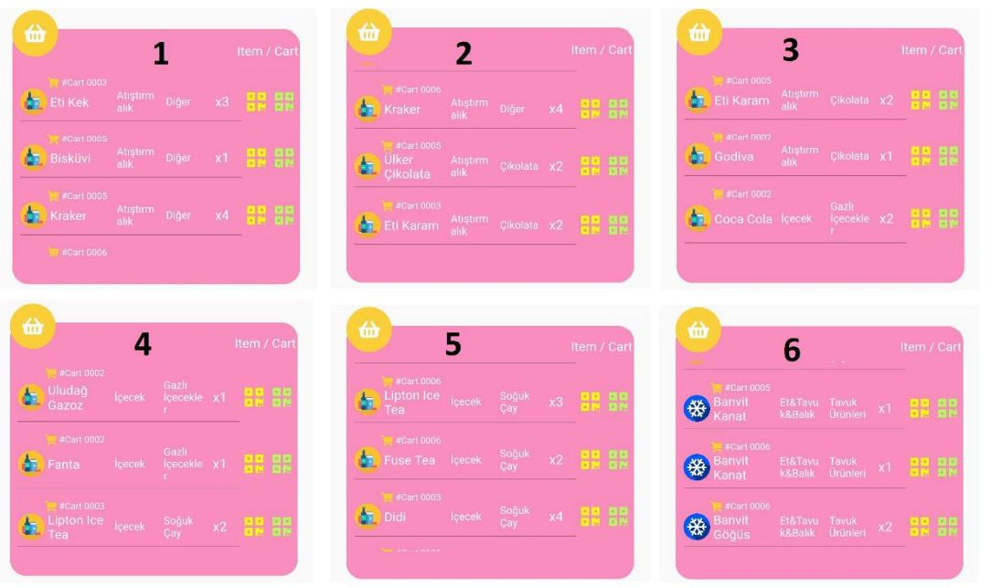
Success CrIterIa - 3
Providing optimal product collection suggestion and the most optimal route.
Picker can prepare more than one order at the same time, in which case it has to ensure that he delivers its products in the most optimal way. Otherwise, it will have to go around the market many times, this project was aimed to prevent this. It was ensured that Picker prepared the orders in one go, and did not spend any unnecessary effort. At this stage, after the products were pulled from the database, they were sorted as (category, sub-category, product name, order number). In other words, category-based sorting was done first, and for those with the same category name, sorting by sub-category, the same situation proceeded as product name and order number. In order to prevent the cold chain products from being exposed to heat and spoiled, a suggestion was made as the last collection.

Slide 24
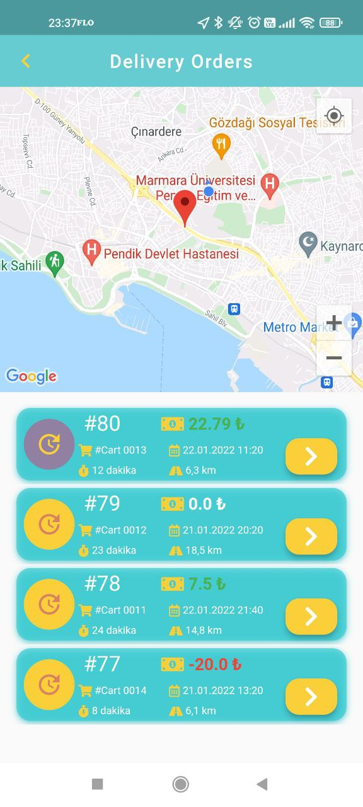
Success CrIterIa - 3
Providing optimal product collection suggestion and the most optimal route.
Packer may have more than one order to deliver to addresses. Delivering orders as soon as possible from their location is a situation that will satisfy both the packer and the customer. The main criteria for optimizing orders are distance and traffic information. Today, the most well-known service that provides this data in a very effective way is the Google Map service. Google Map offers a wide variety of Map APIs. One of them is Directions API, with this API, starting and destination locations are selected, optionally Google offers this route in the most optimal way. While presenting this optimal route, it processes data such as distance to addresses, traffic information and sorts it in the most optimal way. Another API is the Distance Matrix API, which determines the distance and time from the instantaneous location to the destination locations. In this project, both services are provided for Packer. To prove this success criterion with a few examples

Slide 25
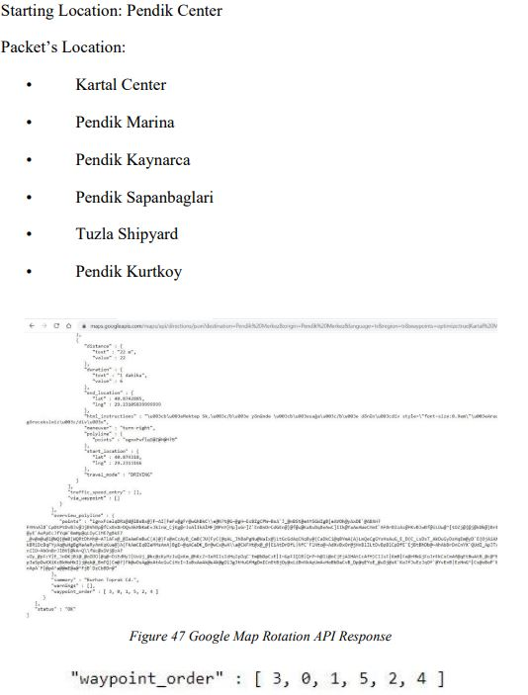
Success CrIterIa - 3
Providing optimal product collection suggestion and the most optimal route.

Slide 26
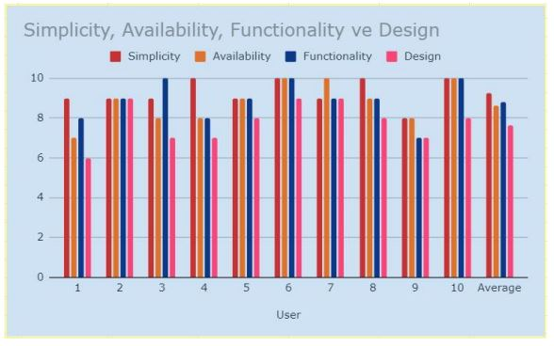
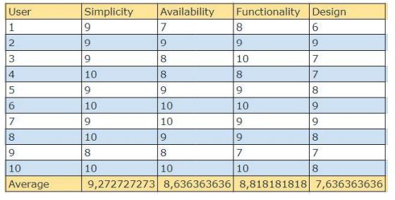
Success CrIterIa - 4
It meets 70% validity criteria when tested by 10 different users. (Simplicity, Usability, Functionality, Design)
As seen in the results, it has received 70% validity in evaluations in terms of
simplicity, usability, functionality, and design

Slide 27
references
Youtube, Deploy a Flask App to Heroku With a Postgres Database [Online], https://www.youtube.com/watch?v=FKy21FnjKS0
Udemy, Scalable Web Applications with Python, Flask, and SQLAlchemy [Online], https://www.udemy.com/course/flask-is-fun-and-easy-from-basics-to-building-scalable-apps/
Udemy, Flutter & Dart - The Complete Guide [2021 Edition][Online], https://www.udemy.com/course/learn-flutter-dart-to-build-ios-android-apps/
Web App in Cloud[Online], https://arctype.com/blog/postgres-heroku/
Google, Maps Platform[Online], https://developers.google.com/maps
Geeksforgeeks [Online], https://www.geeksforgeeks.org/*
Medium [Online], https://medium.com/
Lucidchart [Online], https://lucid.app/lucidchart
Looka, Free Logo Maker [Online], https://looka.com/

